Slide 1
Custom Object Detection using YoloV3
-by Samarth Anand

Slide 2
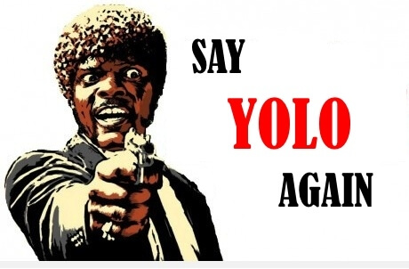
Introduction
Human beings the most wonderful creation of god can easily identify and detect objects in the surroundings, without consideration of their circumstances, like it doesn’t matter what type of object it is. Therefore, it is easy to view the objects present around us. But to detect and recognize similar objects without the interference of human beings i.e. using computers requires lots of computer processing to extract information from the shapes and objects in a picture. So, we are using YOLO (You Only Look Once) which scans the provided image only once and provides an output based on that single processing.

Slide 3
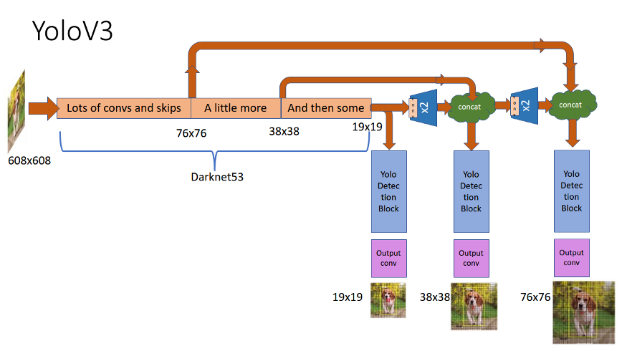
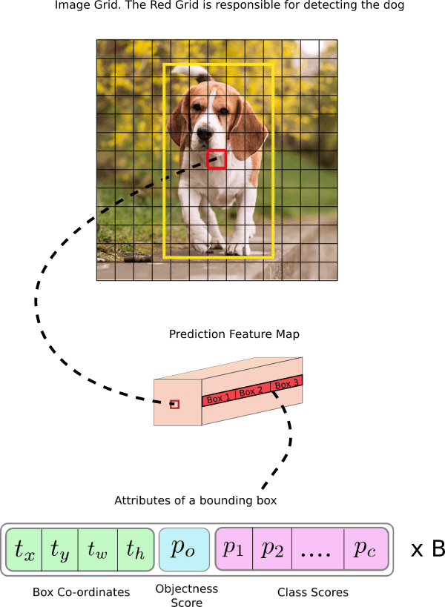
Yolo Architecture

Slide 4
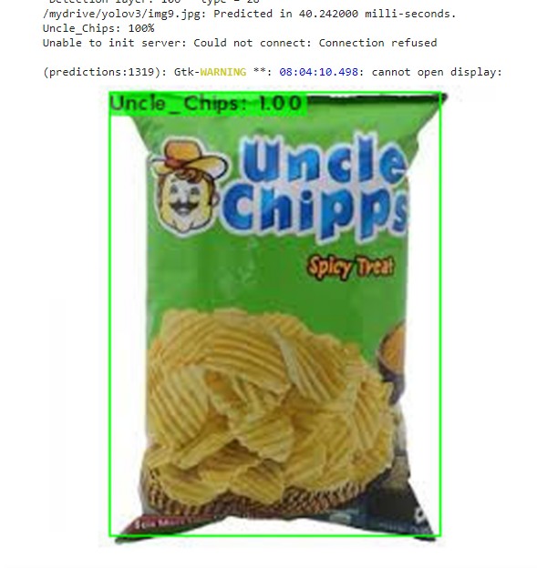
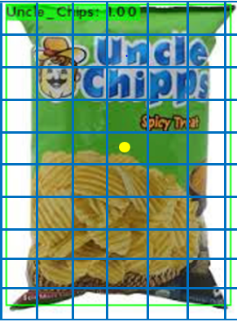

How Yolo Works ?
Pc | 1
Bx | 5
By | 8
Bw | 50
Bh | 70
C1 | 1
C2 | 0

Slide 5
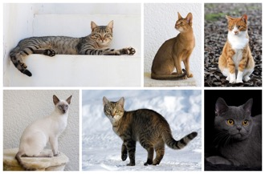
How Neural Network Work ?
Input Layers Hidden Layers Output Layer

Slide 6
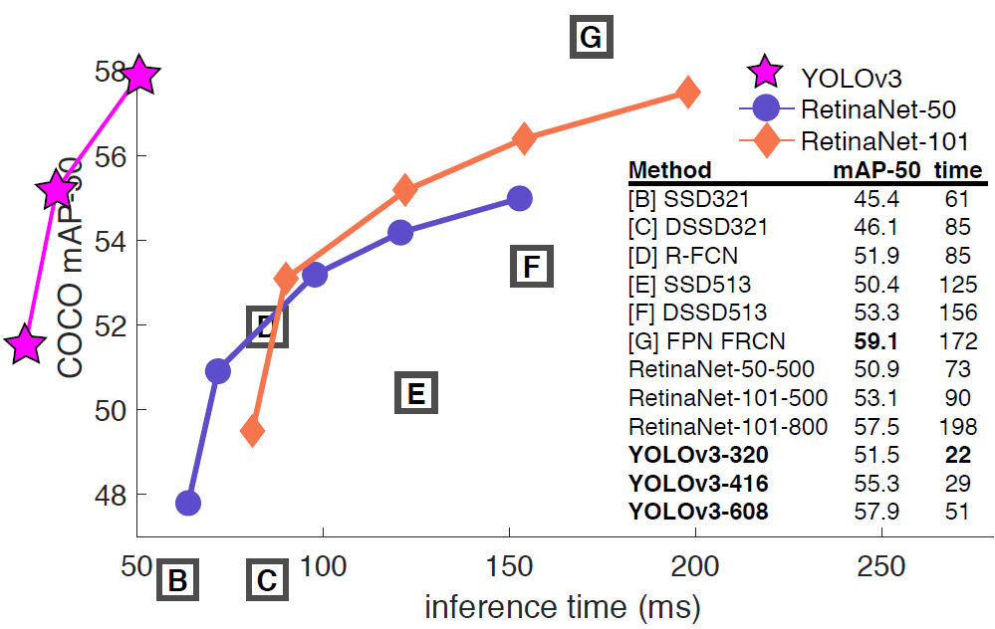
Comparison with other object detection Algorithm

Slide 7
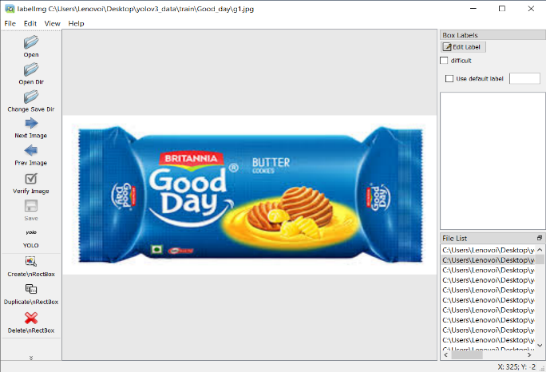
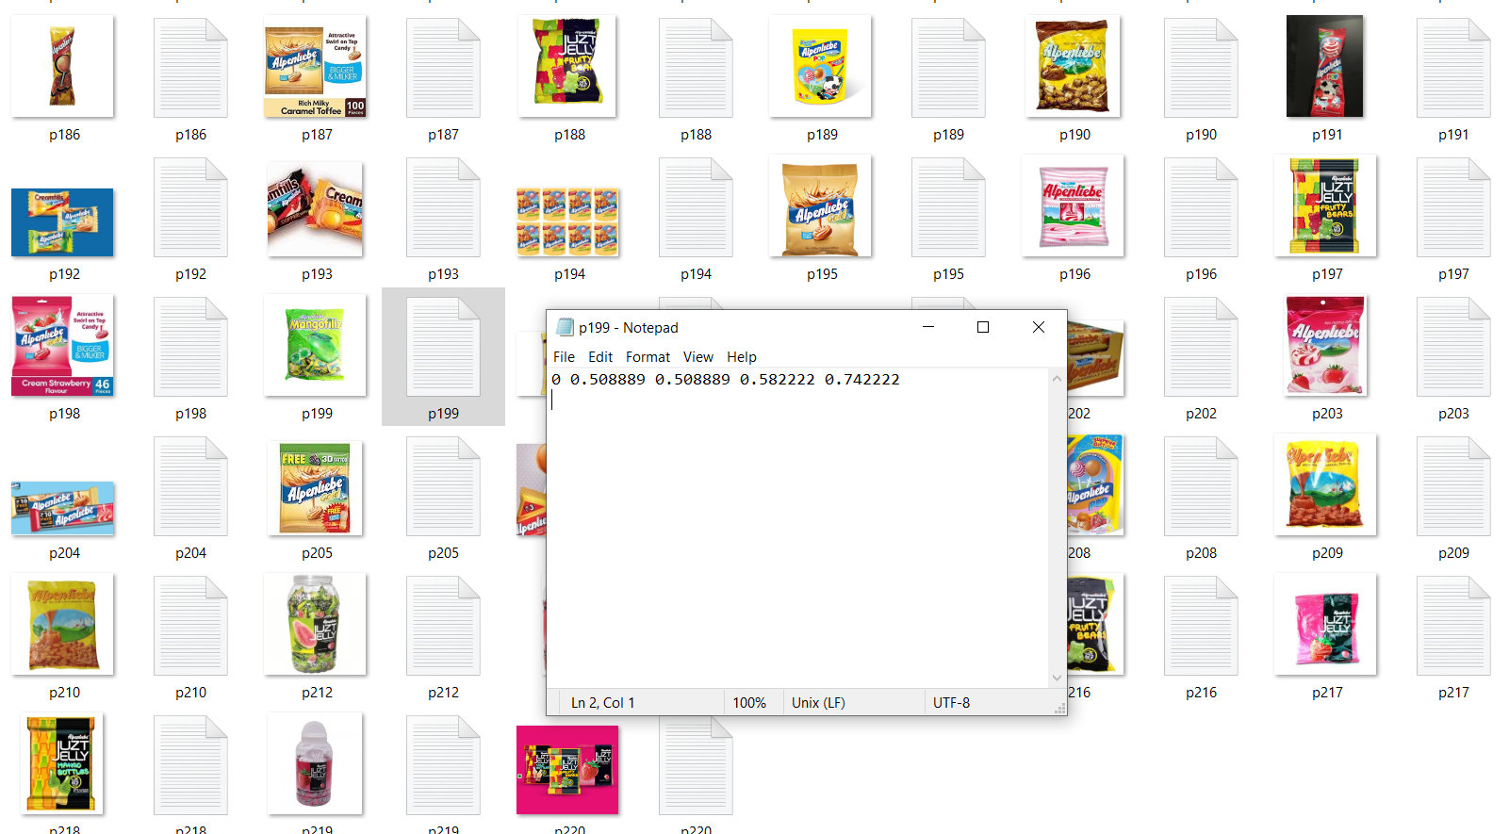
Image Annotation for Training Model
Image Annotation using LabelImg
Annotated Images with their Vector File

Slide 8
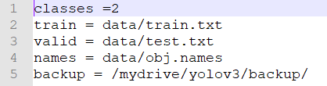

Files Description
For testing in YoloV3 we require Four Files
Files
Data File
Names File
Cfg File
Weight File
It contains no of classes
and path of different folders
It contain names of all trained classes in the given weight file
It contains the required information which weight file needed to perform detection
It contains the detail of objects we want to detect through yolov3 so that the detection occurs

Slide 9
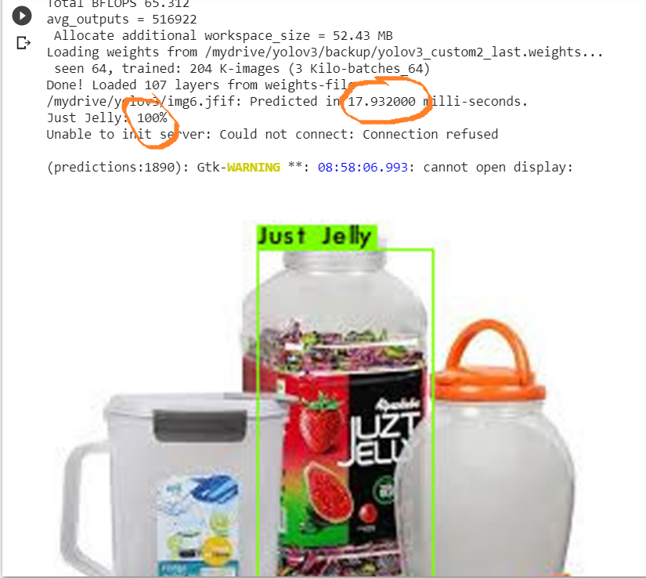
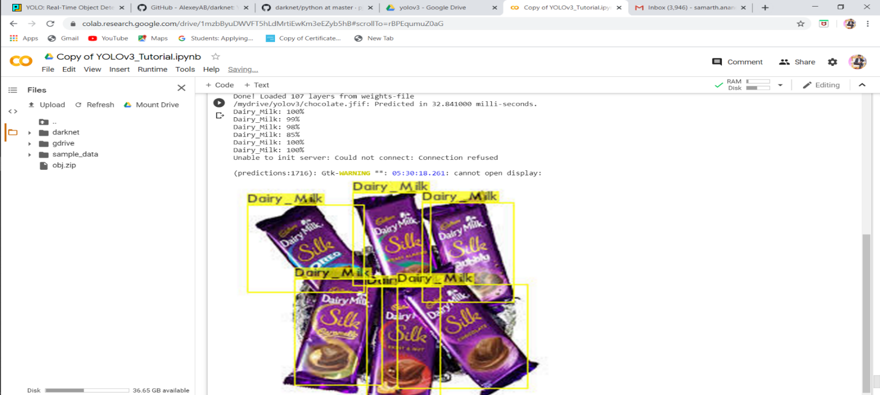
Its use in Shelf Objects
As this algorithm provides high accuracy and speed then other object detection algorithm So, we can use this identify different objects placed in shelf
Then we can further use this algorithm identify the available stocks of identified product
We can setup Complete stock management software to manage the stocks of different available product

Slide 10
Future Works
As to make this project useful for all I have decided to upgrade this project to “ Smart Stock Management Software ” which will manage the availability of stock of different products through custom image detection without any special effort made by the shopkeeper
While using this software you don’t have manage stocks, it automatically manages stocks by monitoring the sell and purchase of the product.
When it finds requirement of any product it automatically informed the dealers about the requirement, So that Shopkeeper doesn’t have to for the stock availability.
It automatically create complete scan based bill to reduce the shopkeeper workload.
In this software I have decided to add chatbots facility with audio accessible feature to make it easy to use for the shopkeeper.

Slide 11
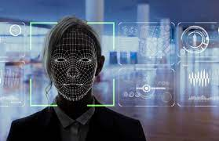
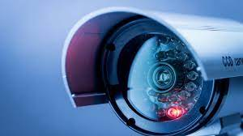
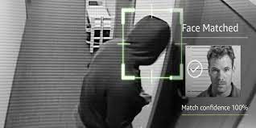
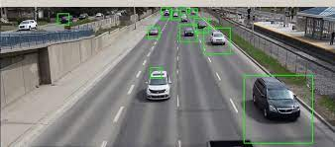
Where it can also be used?
As we have discussed above yolo is an object detection algorithm that provides high speed and accuracy as It looks at the image only once. Hence, It has lots of applications few of them are listed below:
-> Self Driving Cars
-> Detecting Vehicle
-> Security Systems
-> Detecting Criminals
-> Detecting Sign on vehicle
-> Reduce Traffic Jams
-> Face Recognition
-> Automate Systems

Slide 12
Thank You

